Slide 1
Linear regression with Python
https://pub.towardsai.net/calculating-simple-linear-regression-and-linear-best-fit-an-in-depth-tutorial-with-math-and-python-804a0cb23660

Slide 2
NumPy
NumPy (Numerical Python) is the fundamental package for numerical computation in Python; it contains a powerful N-dimensional array object.
Here are the top four benefits that NumPy can bring to your code:
More speed.
Fewer loops
Clearer code
Better quality
Find more details about NumPy here.
Installation: pip install numpy
For simple installation via Anaconda, you can follow the instructions given here.
>>> import numpy as np

Slide 3
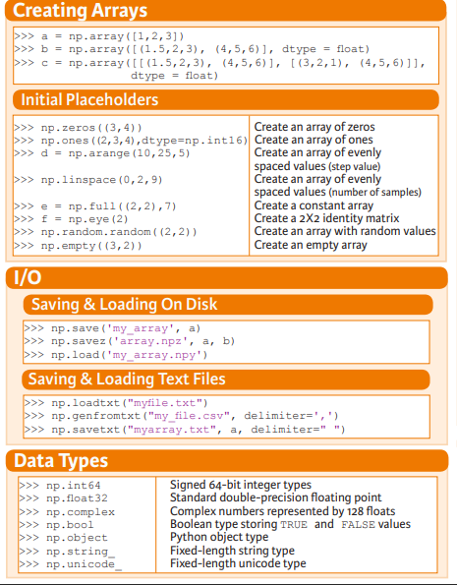
NumPy-Arrays
For learning more ways of array creation check this out.

Slide 4
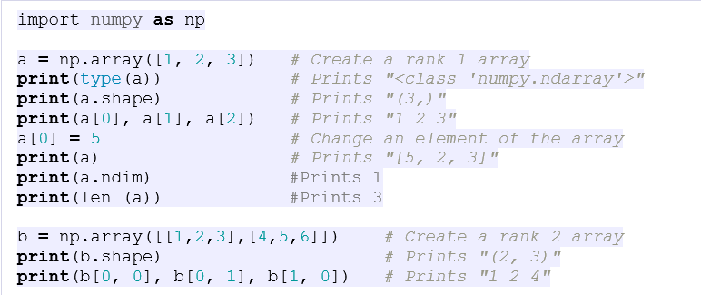
NumPy-Attributes of Array

Slide 5
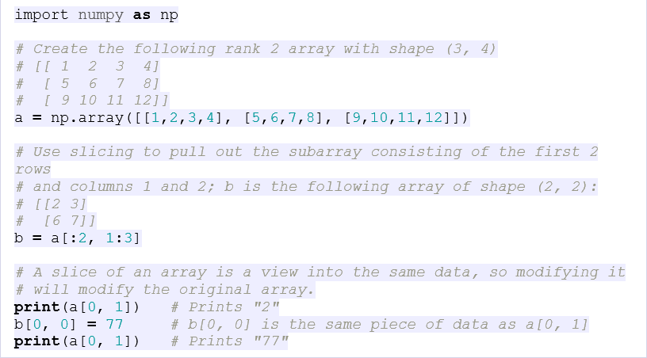
NumPy-Array Slicing and Indexing

Slide 6
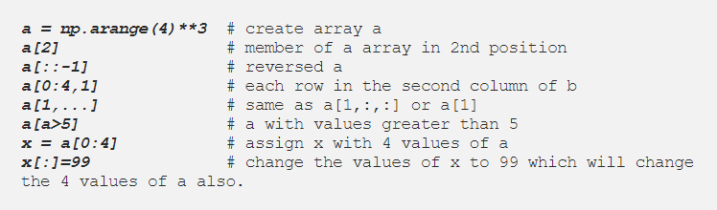
NumPy-Array Slicing and Indexing

Slide 7
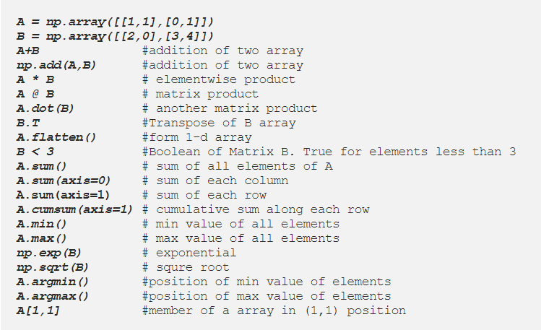
NumPy-Array Operations

Slide 8
NumPy-Array Datatypes

Slide 9
Simple Linear Regression using Scikit-learn

Slide 10

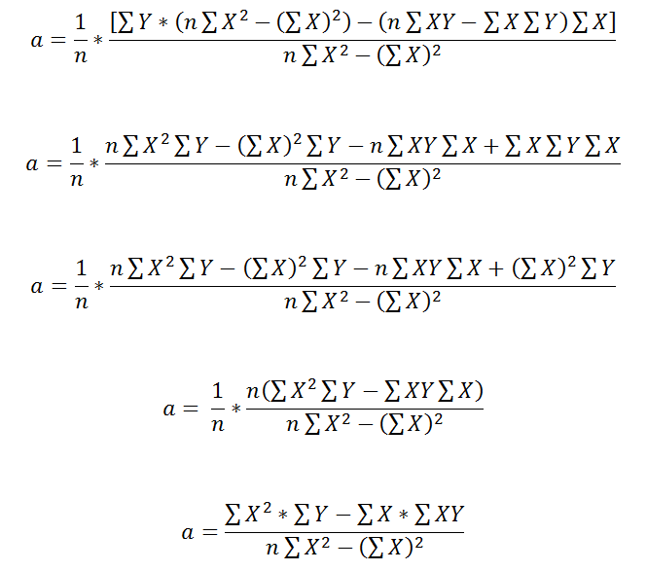
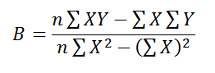
Linear Regression
Recalling last lecture for linear regression our goal was to find the best fit line.
Best Fit line:
Therefore, we need to calculate optimal parameters i.e. Slope(B) and Intercept(a).

Slide 11
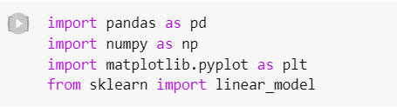
Import Data
The first step is to import/load our dataset in a python file.
To use pandas library, we have to first import it.
Moreover, we are using a built-in library i.e. sklearn for linear regression, therefore, we have to import it.

Slide 12
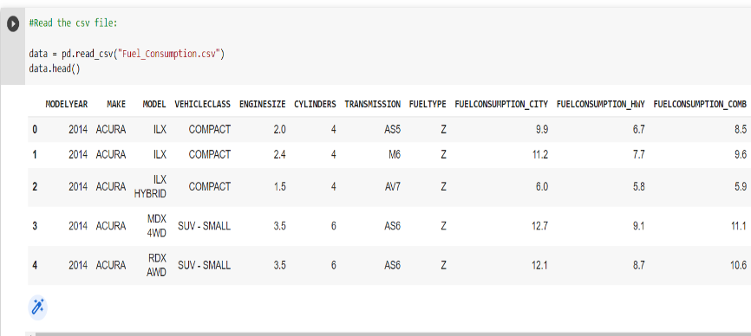
Read the data into the data frame object. (Same as previous)

Slide 13
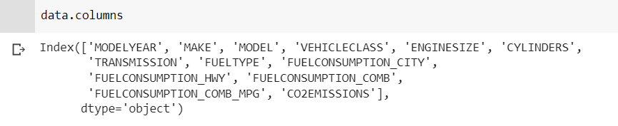
To see the total columns of the dataset.

Slide 14
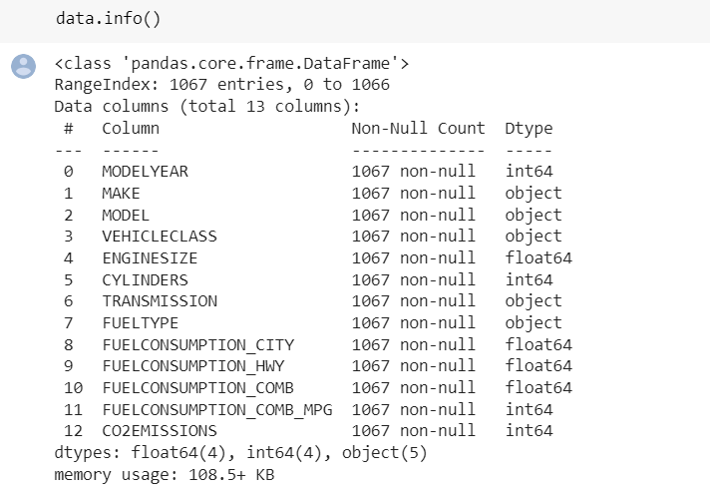
Data Preprocessing
Before fitting the model, we have to check the dataset if any entry is null or not.
If any value is null, we should remove all those null entries. (Same as previously done)

Slide 15
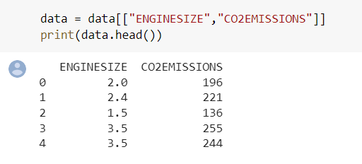
Feature Selection
Select columns to build our model.
Select only those features from our dataset that we are going to use for predictions: (Same as previous)

Slide 16
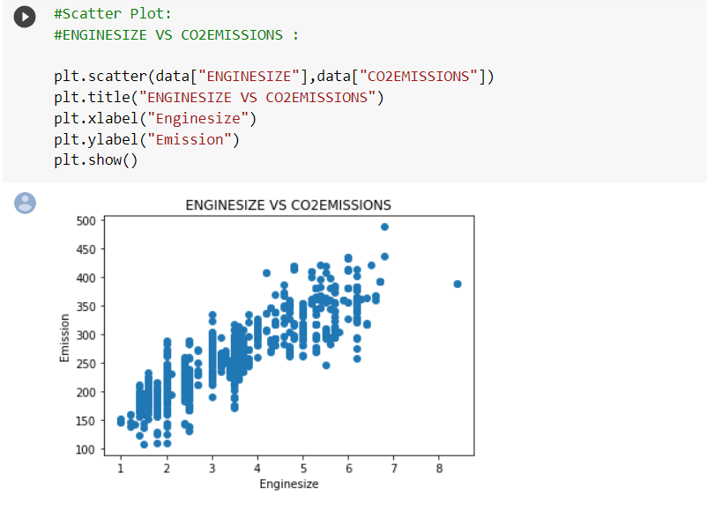
Scatter Plots
Plot the data on the scatterplot: (Same as previous)

Slide 17
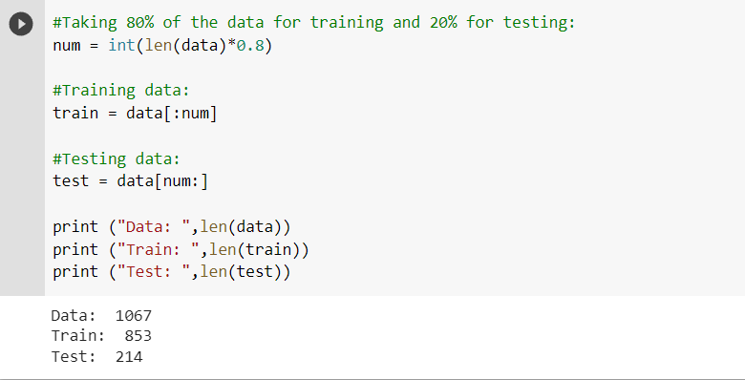
Test and Training Dataset
Divide the data into training and testing dataset. (Same as previous)

Slide 18
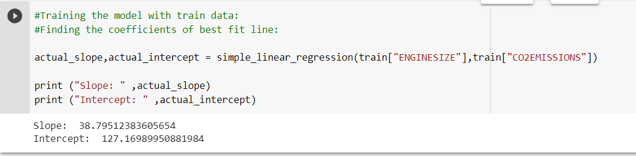
Training Model in Simple Learn Regression
Use the function coded in pervious slide for finding the co-efficients of our actual dataset.

Slide 19
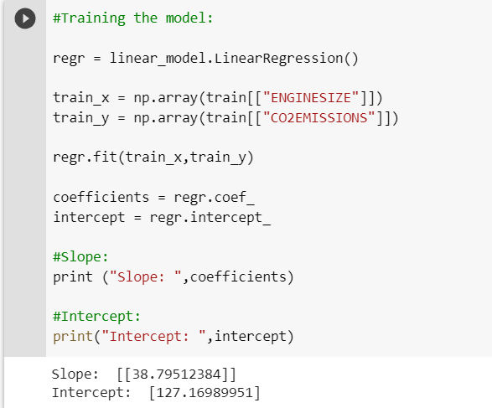
Sklearn - Linear Regression
From the imported linear model use Linear Regression Model.

Slide 20
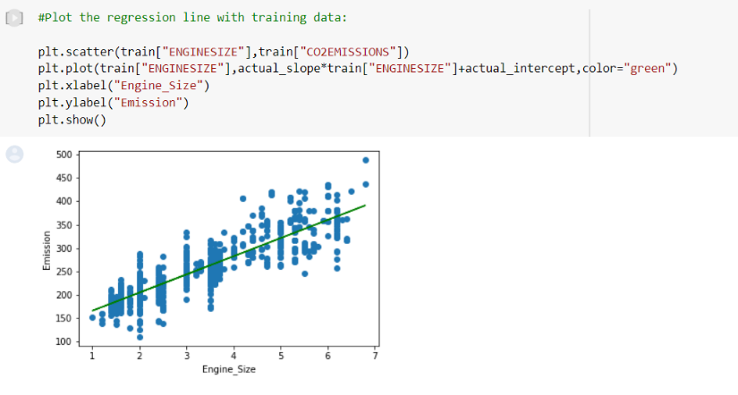
Plotting Best fit line for Simple Linear Regression
Plot the regression line with actual data.

Slide 21
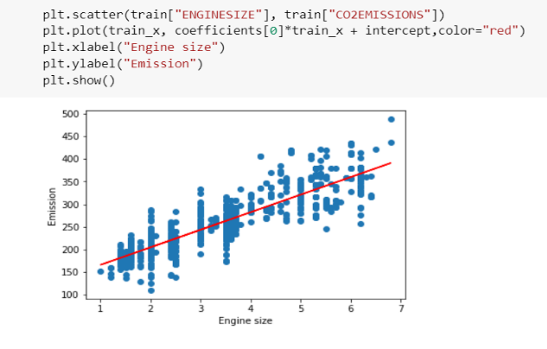
Plotting Best fit line for Sklearn- Linear Regression
Plot the regression line on training data.

Slide 22
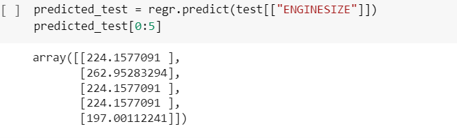
Prediction using Sklearn- Linear Regression
Predicting values for test dataset.

Slide 23
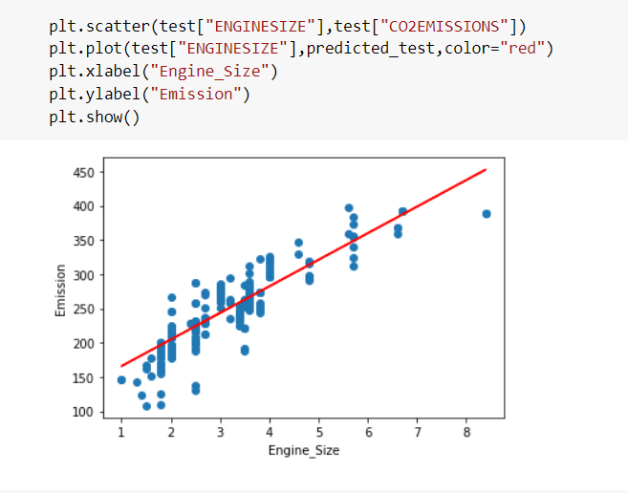
Fitting model on Test data using Sklearn
Plotting the test data with the regression line.

Slide 24
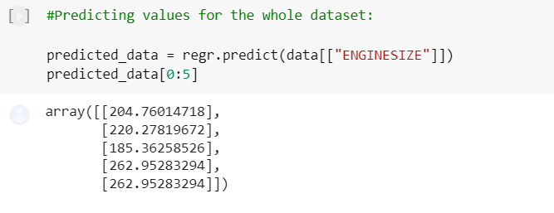
Predicting for Complete Dataset
Predicting values for the complete dataset:

Slide 25
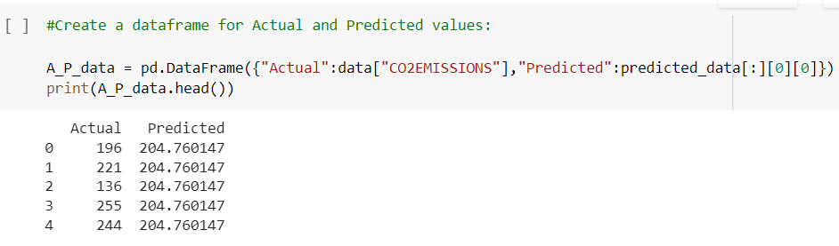
Actual vs. Predicted Values
Create a data frame for actual and predicted values:

Slide 26
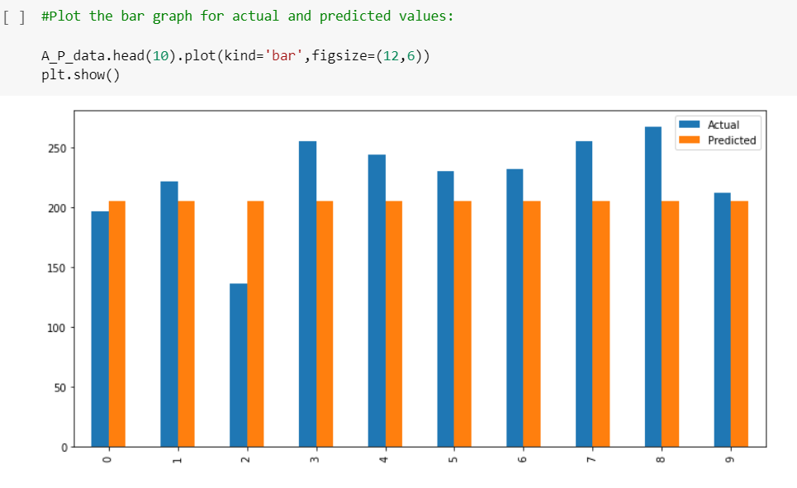
Actual vs. Predicted Values
Create a data frame for actual and predicted values:

Slide 27
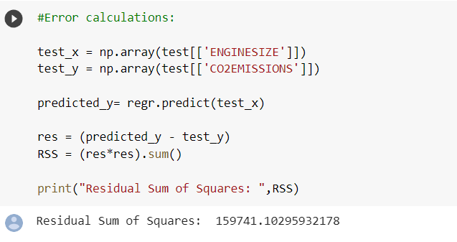
Error- Residual Sum of Squares
Calculating error:

